Slide 1


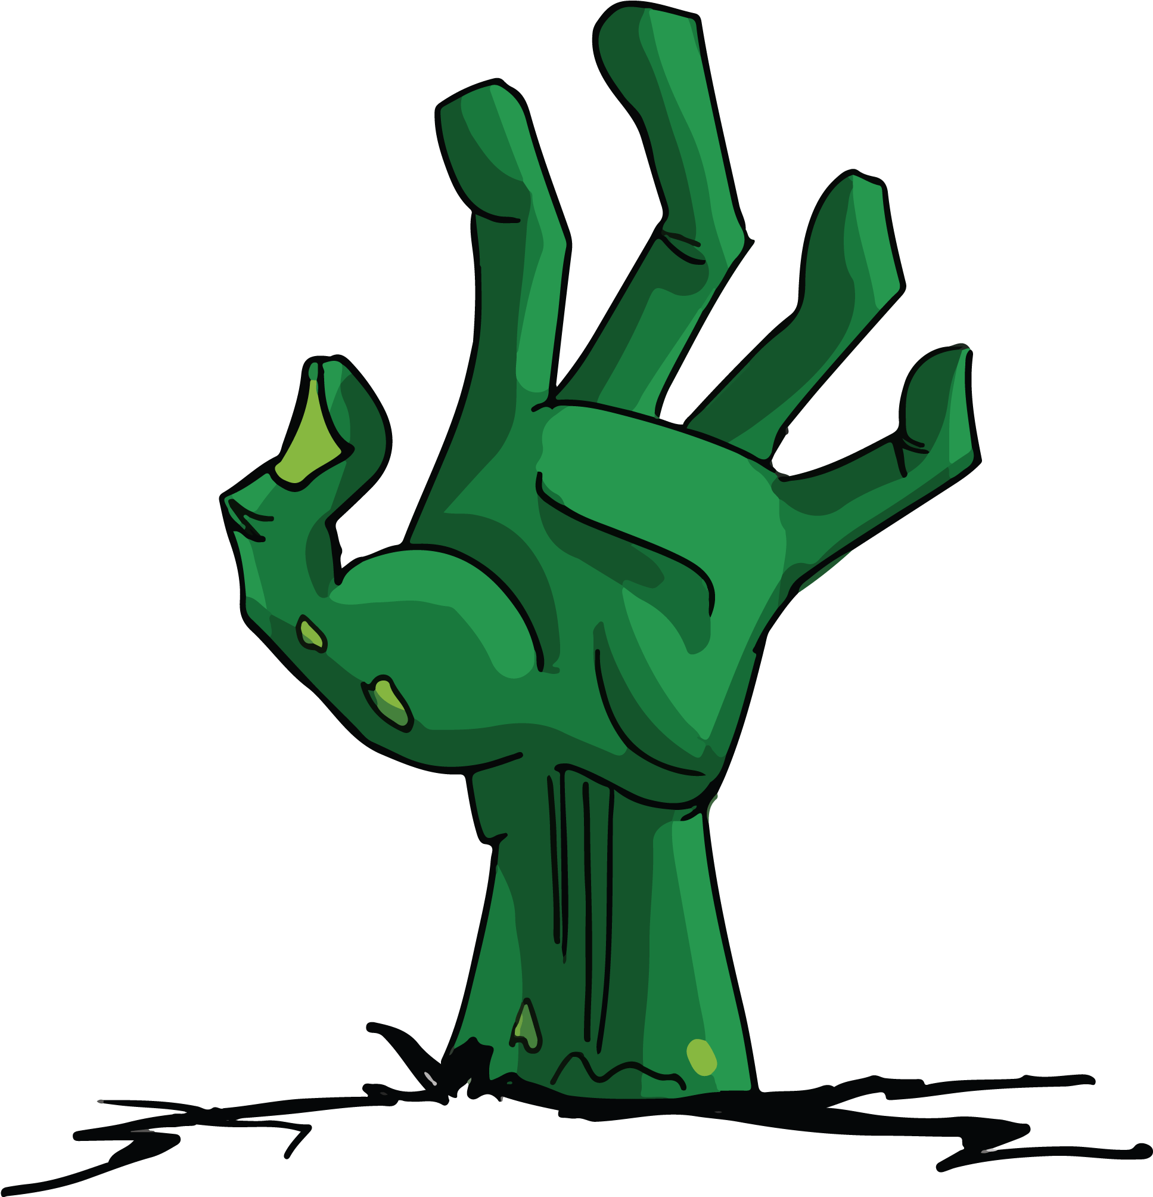

Necro Nursery
Team Abra-cadaver

Slide 2

Narrative
Wrote dialogue for mentor and merchant.
World Bible and High Concept Documents updated
Minigame Backgrounds curated

Slide 3

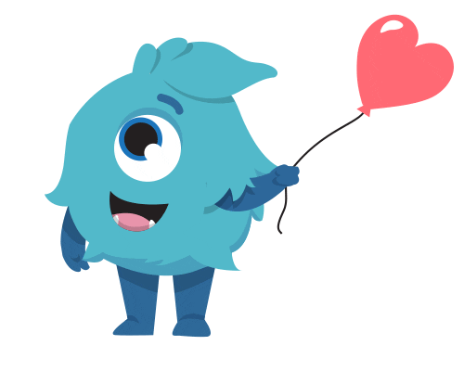
Audio
Created version 1 of new minigame music soundtracks
Concepts of sounds for future soul minigame soundtrack(s)

Slide 4





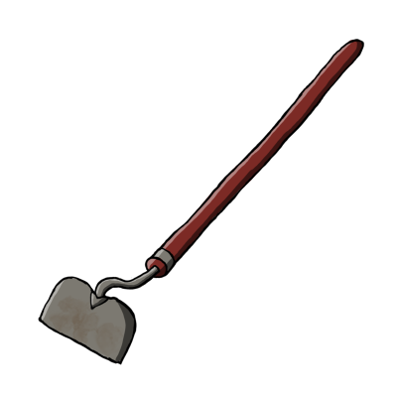

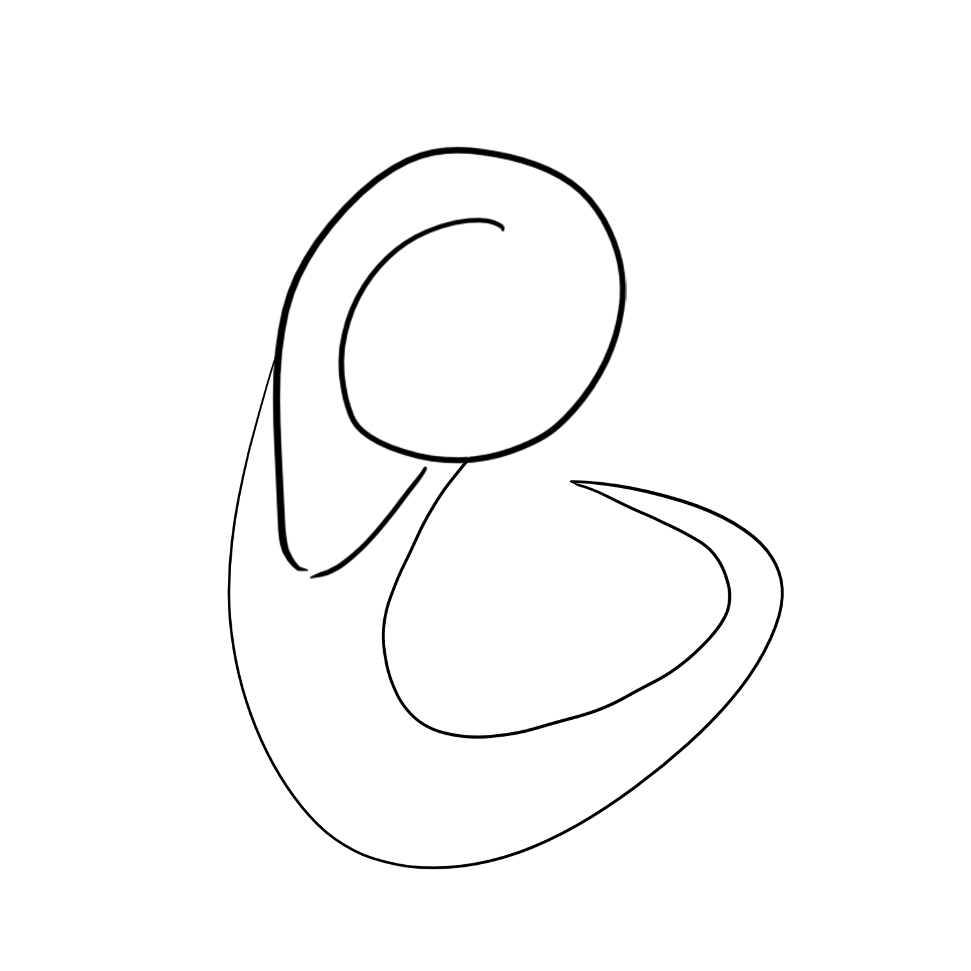

Slide 5
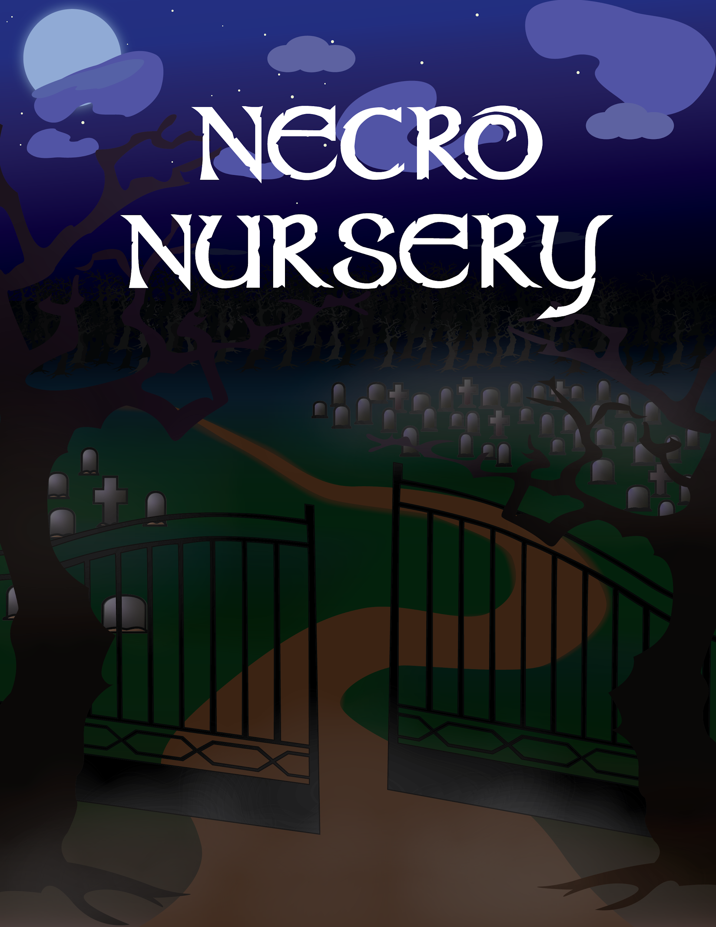

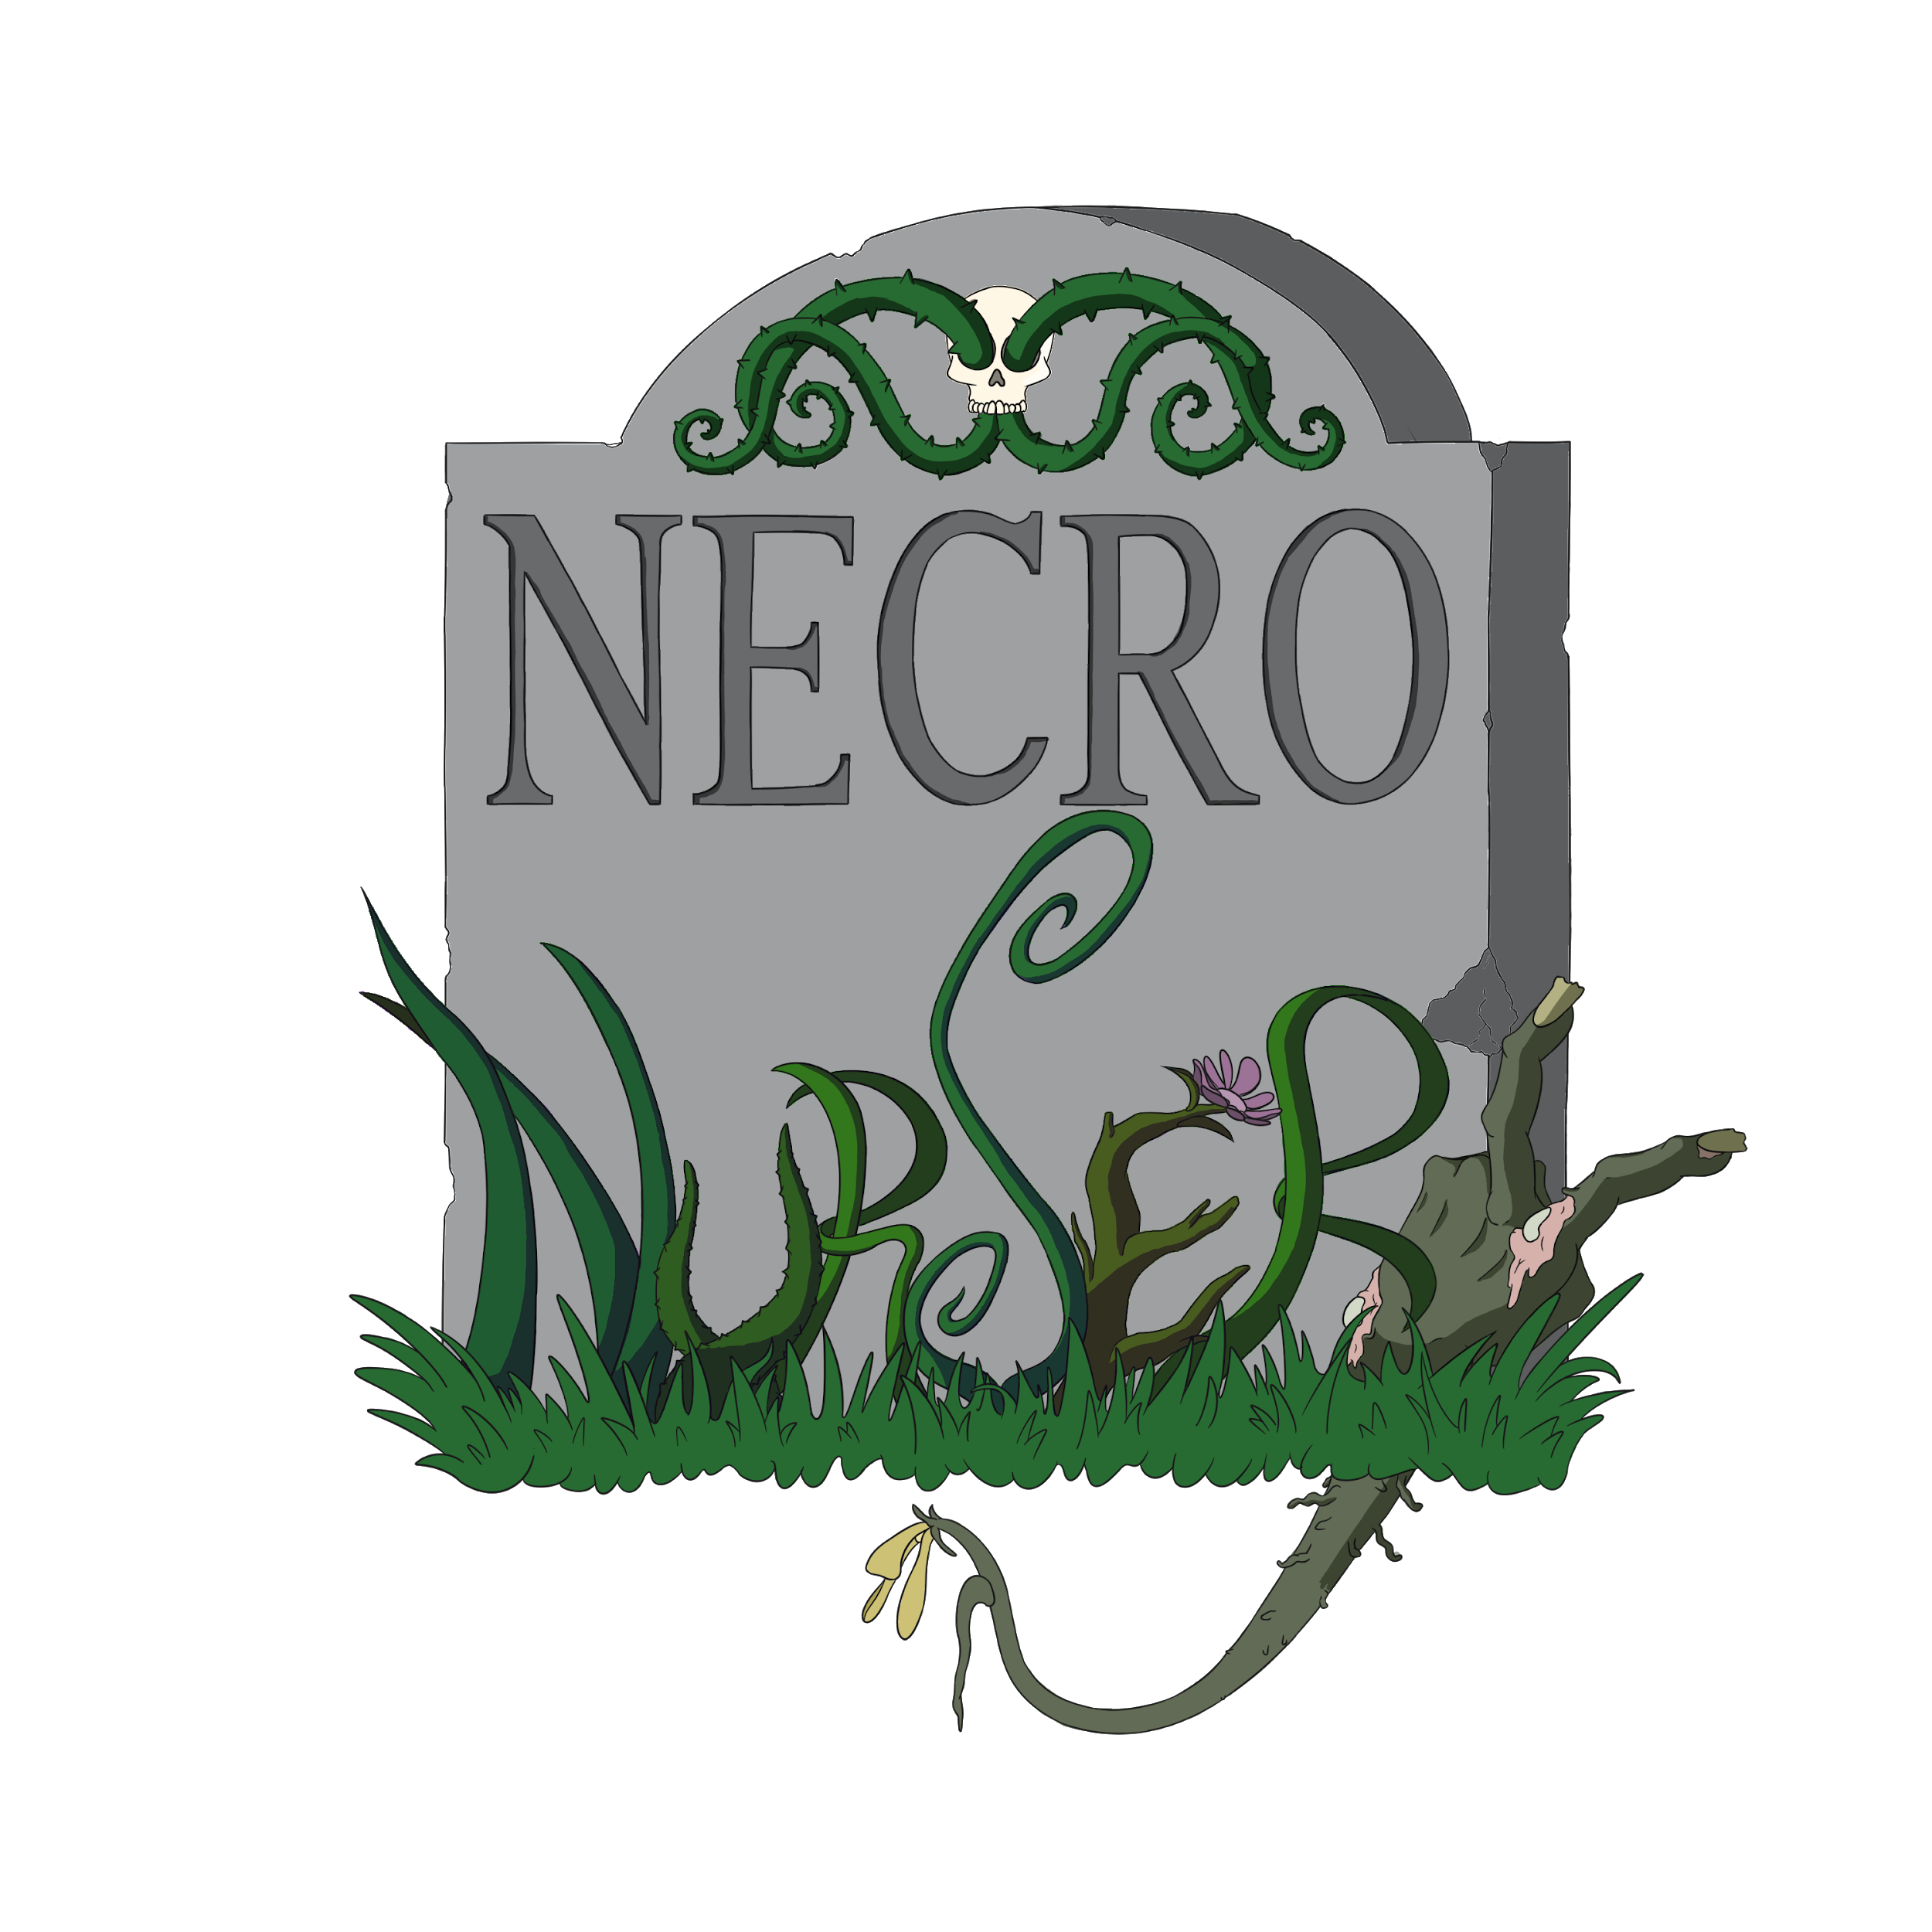
(Still in progress)
10 WBs spent on this, don’t know how to color it :(
(thank you Brooke and Jack)

Slide 6

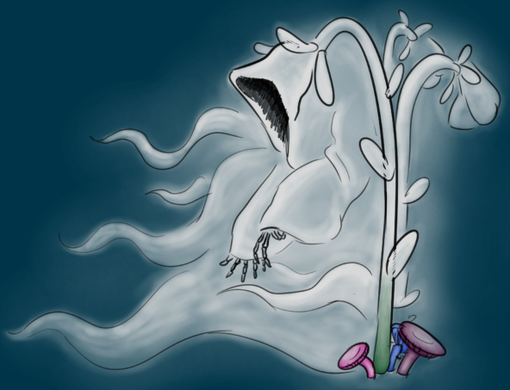
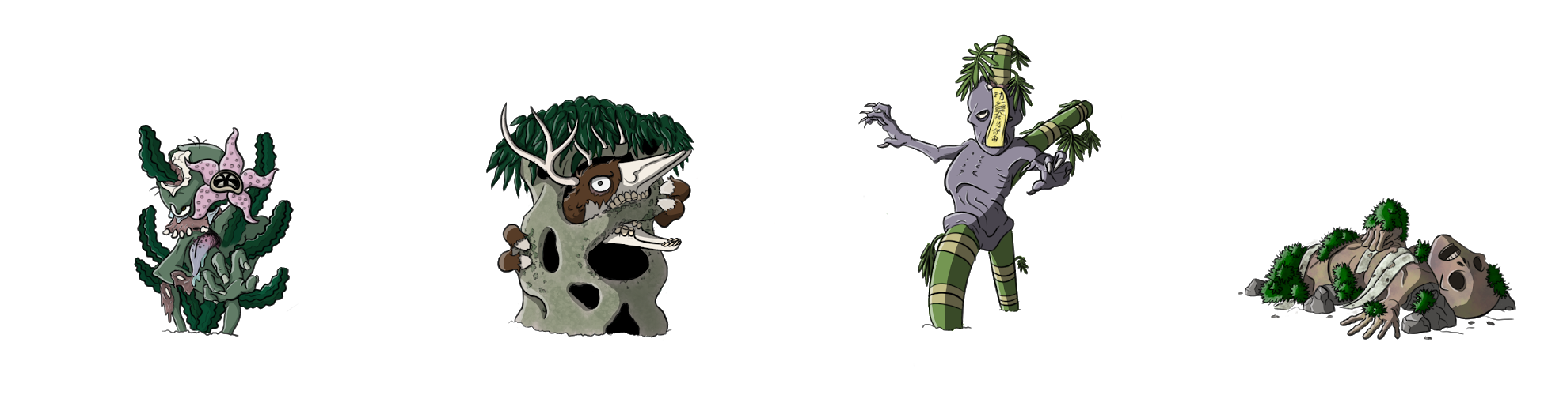

Slide 7

Programming
Loading is now less destructive
Added tutorial scene when first opening the app
New Minigames started
Summoning master
Potion Brewing
Added Dialogue to Tutorial and Market Scenes

Slide 8
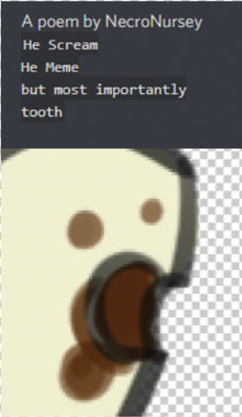
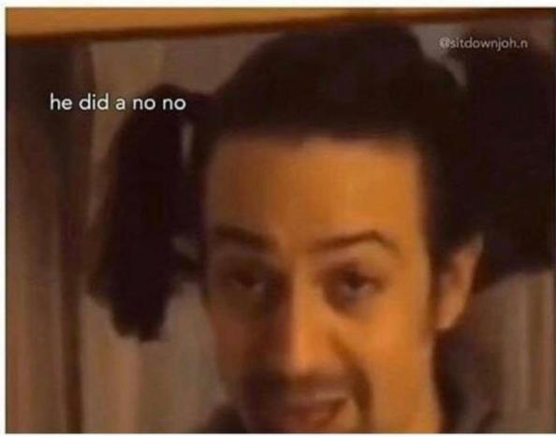
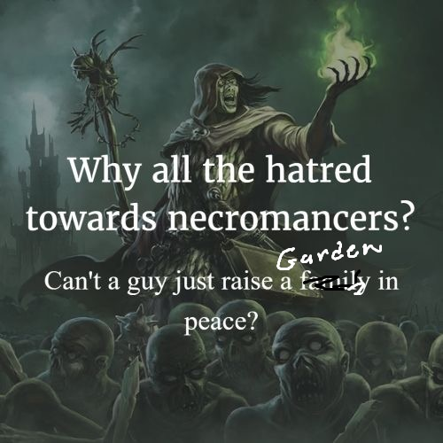
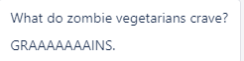
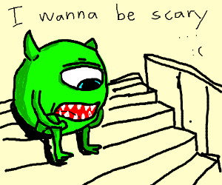
Questions?

